Slide 1
Convenience Channel BUNN Equipment Program

Slide 2
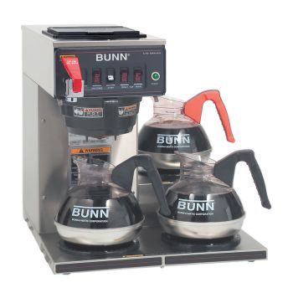
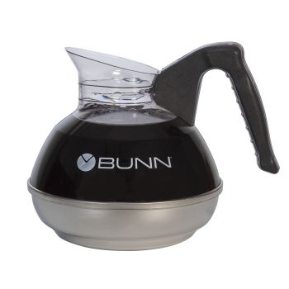
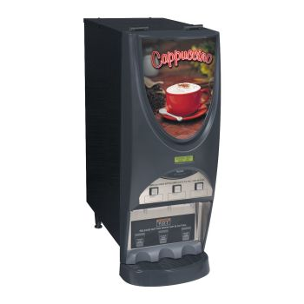
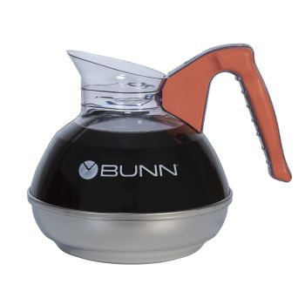
Glass Pots – Convenience Channel ~ 30 +/- Cups per day (420+ lbs/year)
CWTF15-3
https://commercial.bunn.com/12950.0212
Easy Pour, Black Handle (case of 2)
https://commercial.bunn.com/06100.0102
iMIX-3S+ (top hinge)
https://commercial.bunn.com/38600.0050
Easy Pour, Orange Handle (single pack)
https://commercial.bunn.com/06101.0101
Equipment Package Summary
1 Brewer
3 Glass pots
1 three head iMIX Cappuccino/hot cocoa machine (optional)

Slide 3
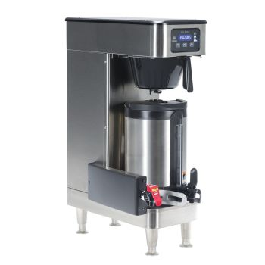
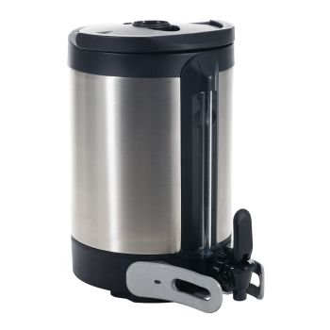
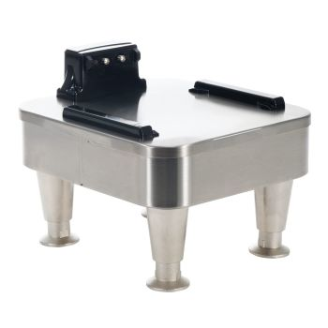
Tier 1 – Convenience Channel ~ 35-45+ Cups per day (450+ lbs/year)
ICB SH Soft Heat, DV 120/208-240V
https://commercial.bunn.com/51100.0103
1.5 Gal SH Server
https://commercial.bunn.com/27850.0200
iMIX-3S+ (top hinge)
https://commercial.bunn.com/38600.0050
1 SH Stand, 120V
https://commercial.bunn.com/27825.0200
Equipment Package Summary
1 Brewer
2 Servers (optional +1 additional server)
1 Stand (optional +1 additional stand or one 2SH Stand #27875.0200)
1 three head iMIX Cappuccino/hot cocoa machine

Slide 4
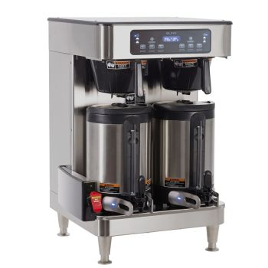
Tier 2 – Convenience Channel ~ 46-59 cups per day (600+ lbs/year)
ICB Twin Soft Heat
https://commercial.bunn.com/51200.0102
1.5 Gal SH Server
https://commercial.bunn.com/27850.0200
iMIX-3S+ (top hinge)
https://commercial.bunn.com/38600.0050
1 SH Stand, 120V
https://commercial.bunn.com/27825.0200
Equipment Package Summary
1 Brewer
3 Servers (optional +1 additional server)
1 Stand (optional +1 additional stand or one 2SH Stand #27875.0200)
1 three head iMIX Cappuccino/hot cocoa machine

Slide 5
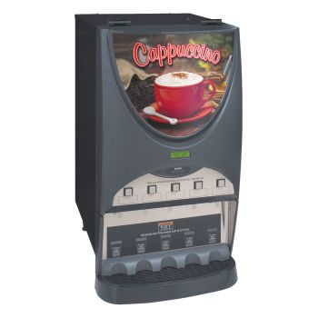
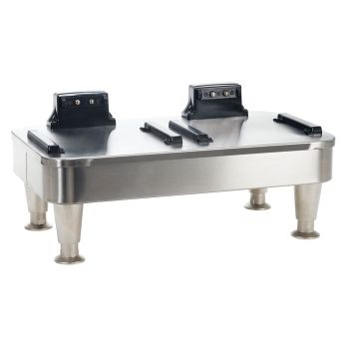
Tier 3 – Convenience Channel ~ 60+ Cups per day (750+ lbs/year)
ICB Twin Soft Heat
https://commercial.bunn.com/51200.0102
1.5 Gal SH Server
https://commercial.bunn.com/27850.0200
iMIX-5S+ (top hinge)
https://commercial.bunn.com/38100.0050
2 SH Stand, 120V
https://commercial.bunn.com/27875.0200
Equipment Package Summary
1 Brewer
4 Servers (optional +1 additional server)
1 2SH Stand
1 five head iMIX Cappuccino/hot cocoa machine

Slide 6
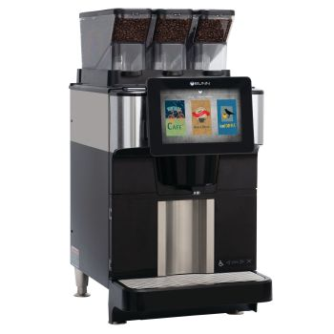
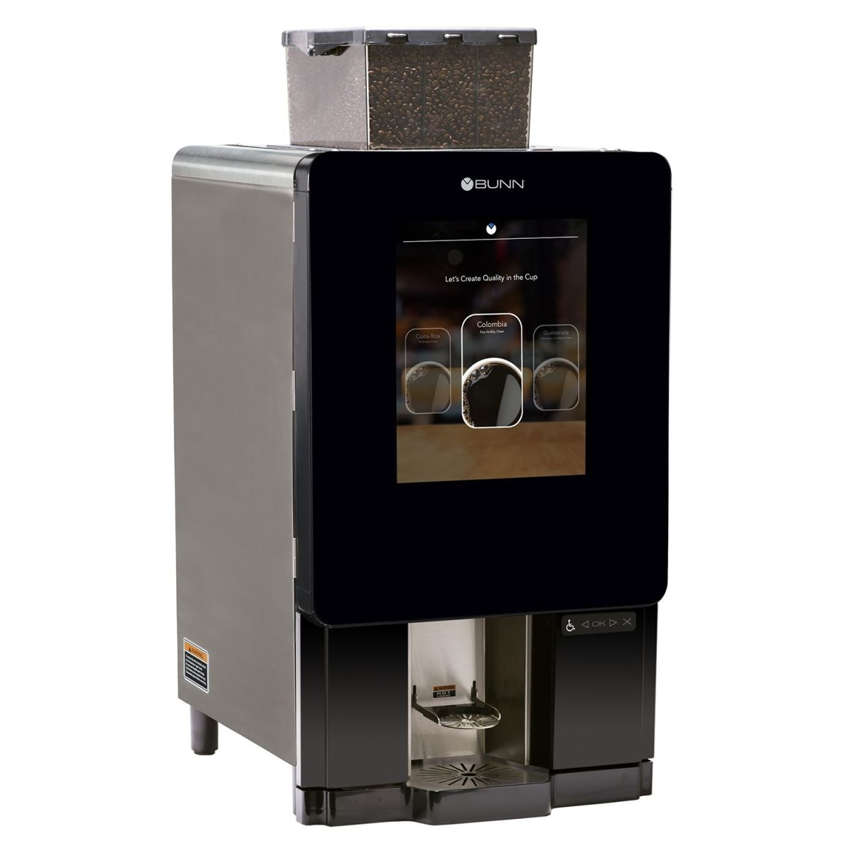
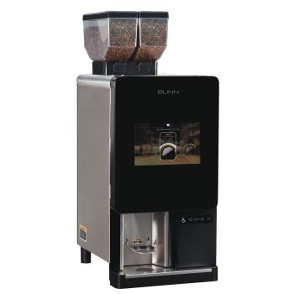
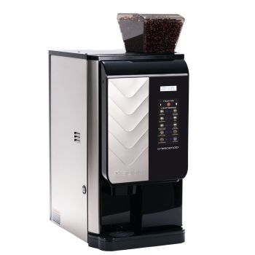
Bean to Cup – Optional
FAST CUP, 208-240V 60HZ
w/BUNNlink WiFi
https://commercial.bunn.com/55400.0105
Sure Immersion 312
https://commercial.bunn.com/44400.0200
Sure Immersion 220
https://commercial.bunn.com/44400.0100
Crescendo
https://commercial.bunn.com/44300.0201
Customer Purchase Option

Slide 7
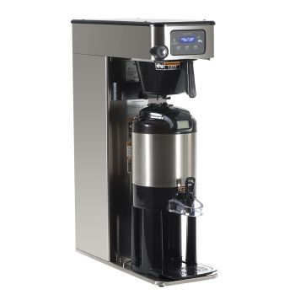
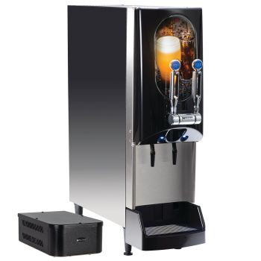
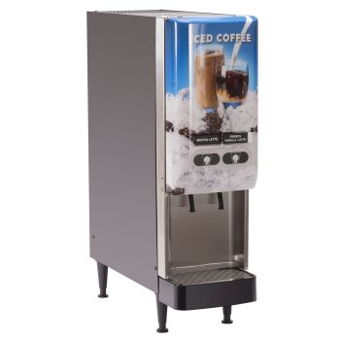
Cold Brew – Optional
NITRON® w/Nitron Gas Module
https://commercial.bunn.com/51600.0028
JDF-2S Lit Door
https://commercial.bunn.com/37900.0009
ITCB-DV-HV
https://commercial.bunn.com/52300.0100
Customer Purchase Option

Slide 8
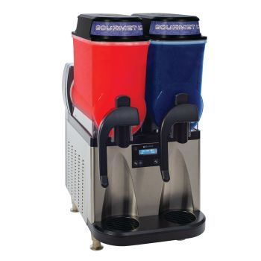
Frozen/Slushy – Optional
Utlra NX, 102V BLK/SST, Manual Fill
https://commercial.bunn.com/58000.0015
Utlra NX, 102V BLK/SST, Liquid Autofill CFV
https://commercial.bunn.com/58000.0016
Customer Purchase Option

Slide 9
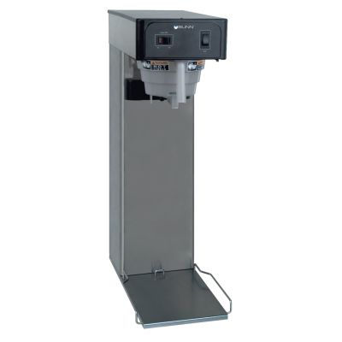
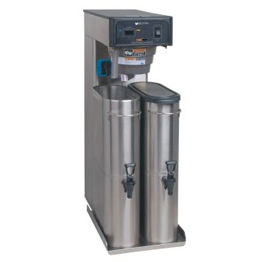
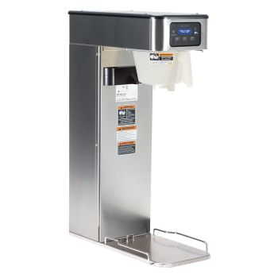
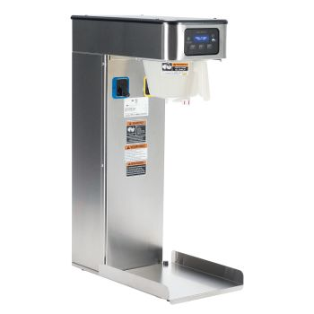
Iced Tea – Optional
TB3Q w/29” Trunk
https://commercial.bunn.com/36700.0013
TB6/TB6Q w/29” Trunk
https://commercial.bunn.com/36700.0300
https://commercial.bunn.com/36700.0301
ITB/ITB Dual Dilution
https://commercial.bunn.com/52000.0100
https://commercial.bunn.com/52000.0301

Slide 10
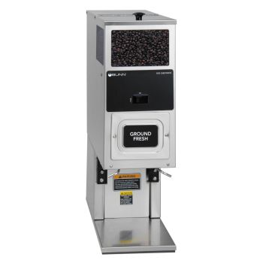
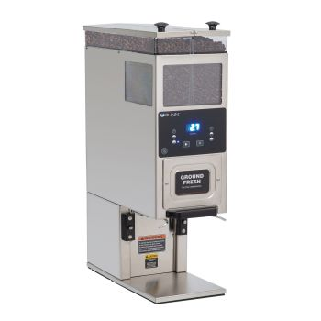
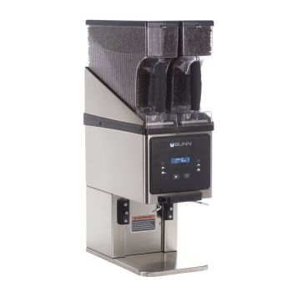
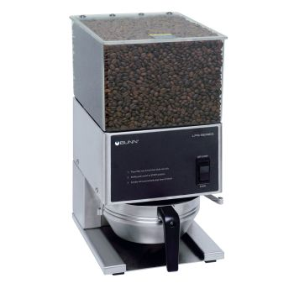
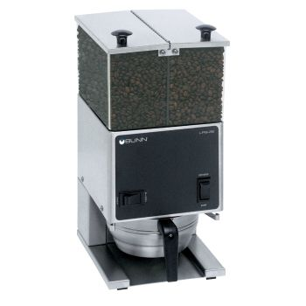
Grinders – Optional
LPG/LPG2E
https://commercial.bunn.com/20580.0001
https://commercial.bunn.com/26800.0000
G9T HD Tall/G9-2T DBC Tall
https://commercial.bunn.com/05800.0003
https://commercial.bunn.com/33700.0000
MHG
https://commercial.bunn.com/35600.0020

Slide 11
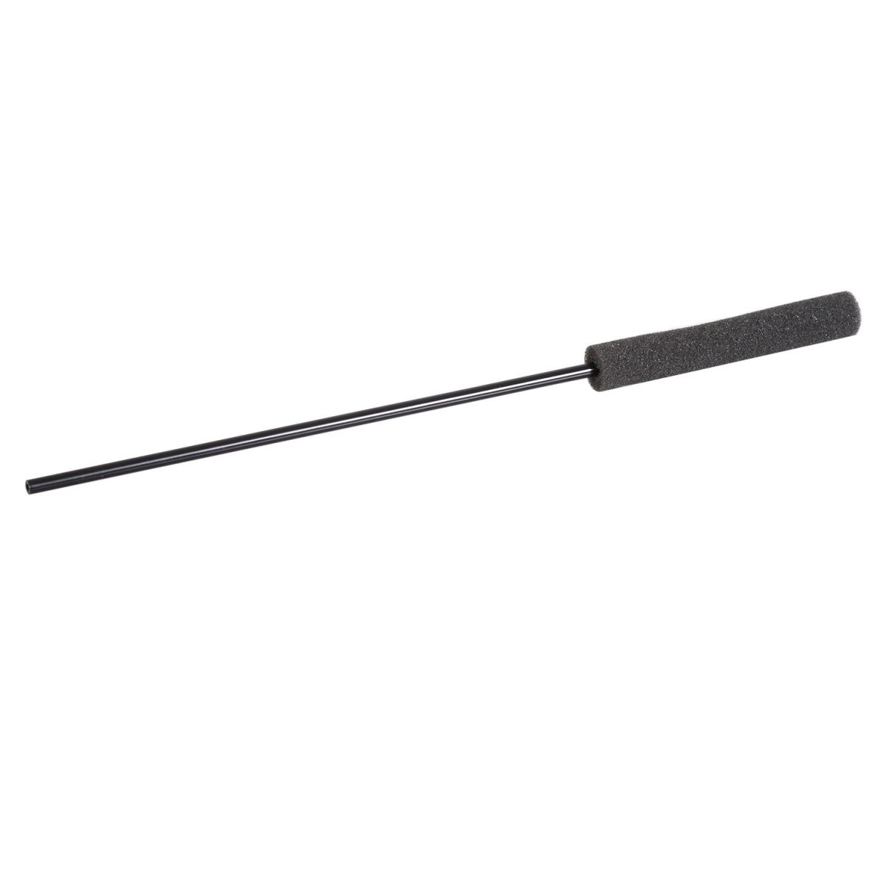
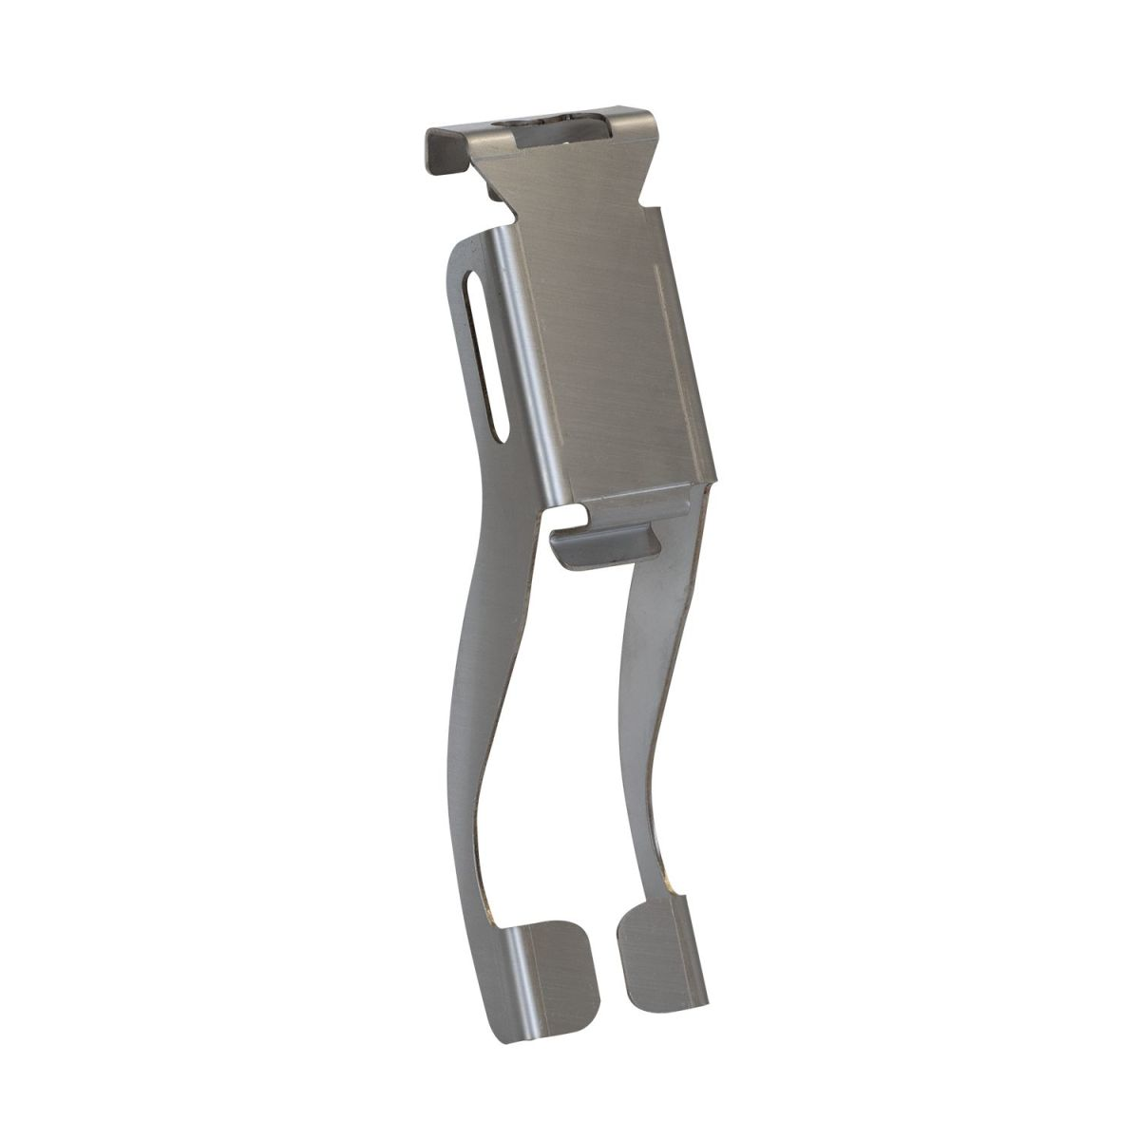
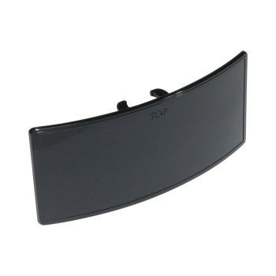
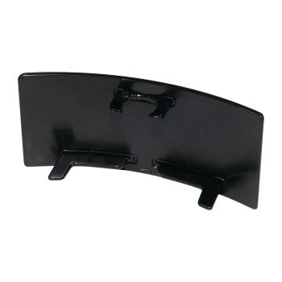
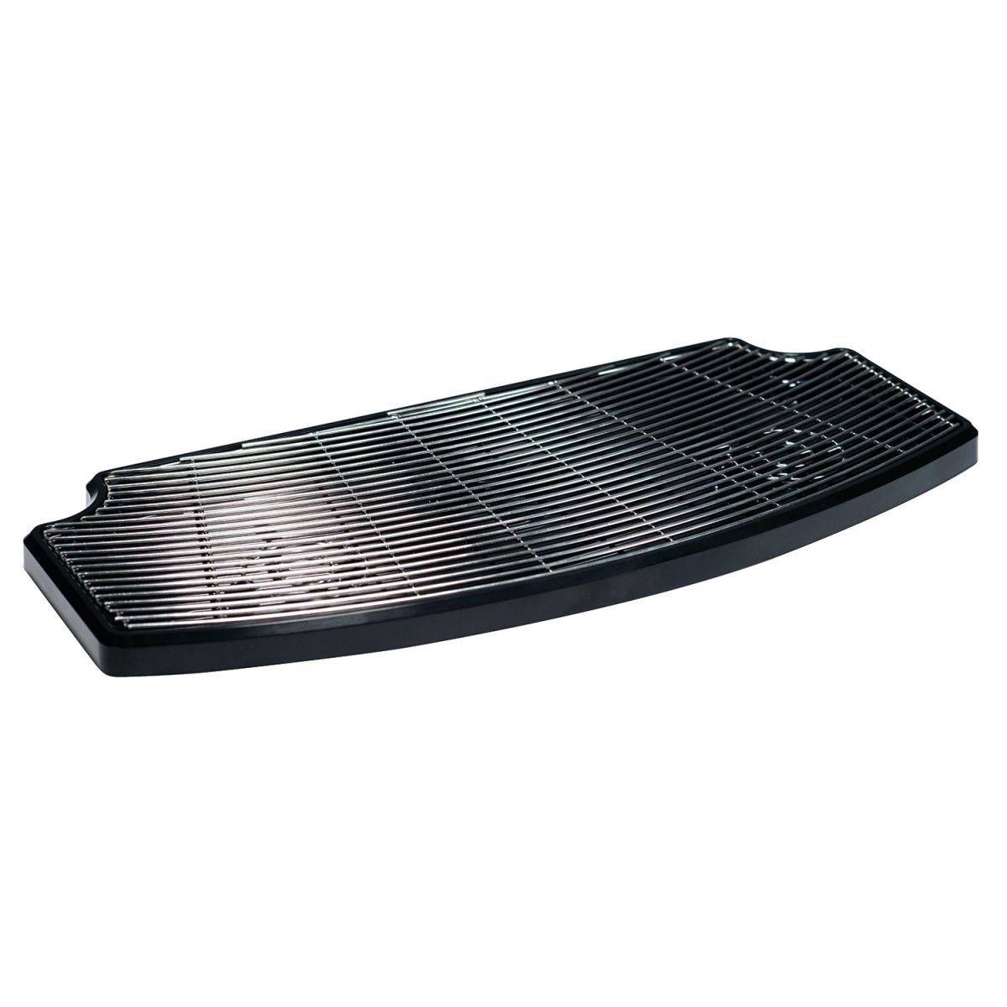
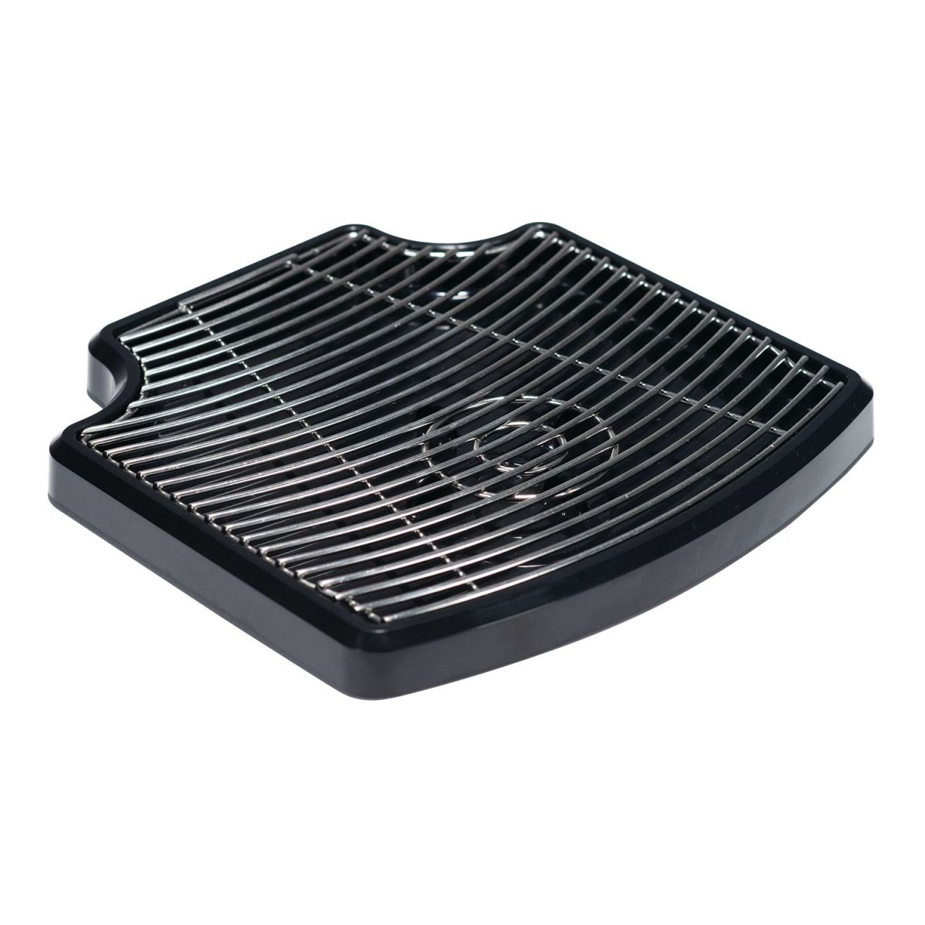
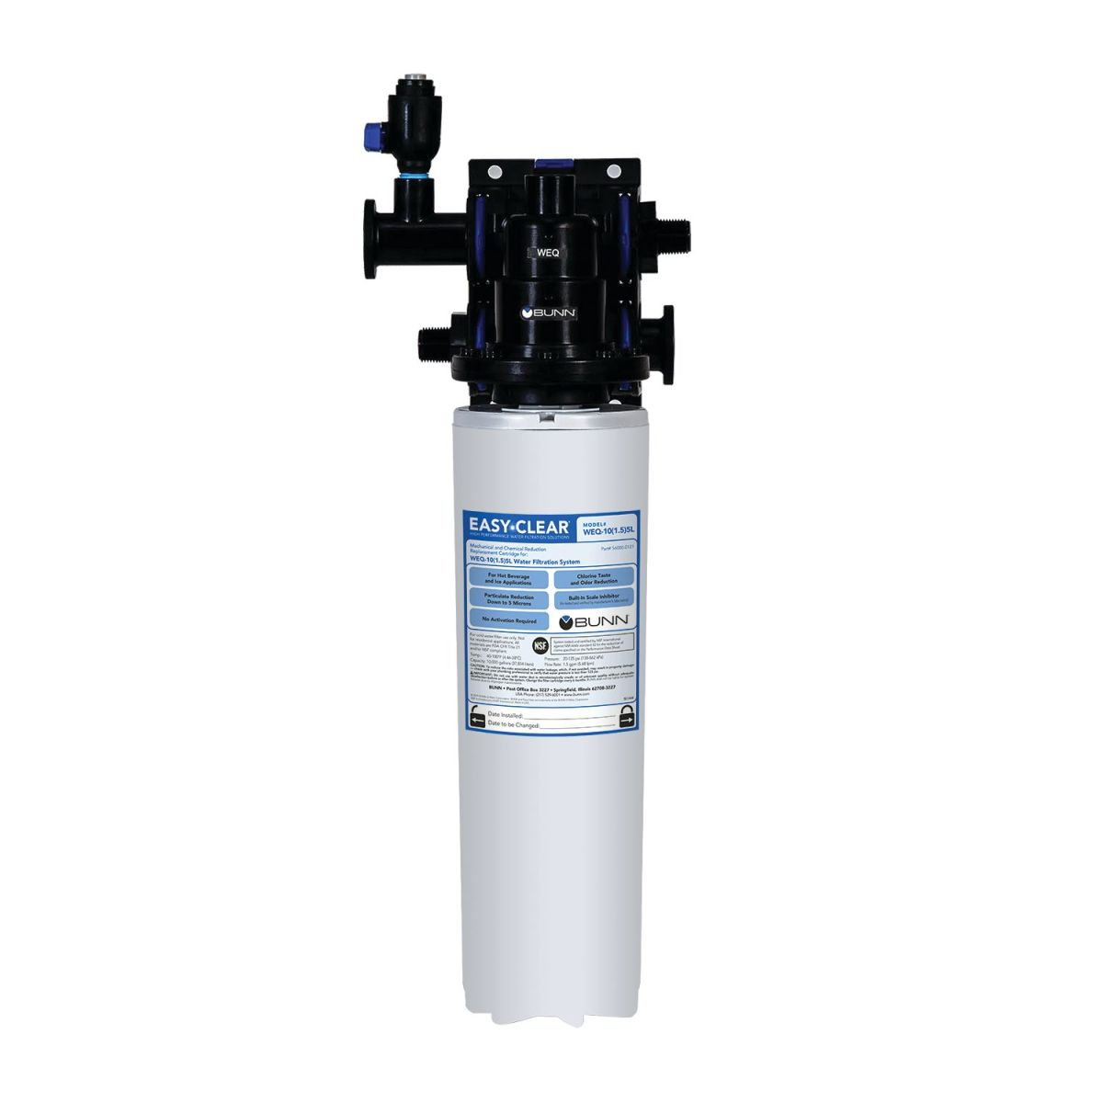
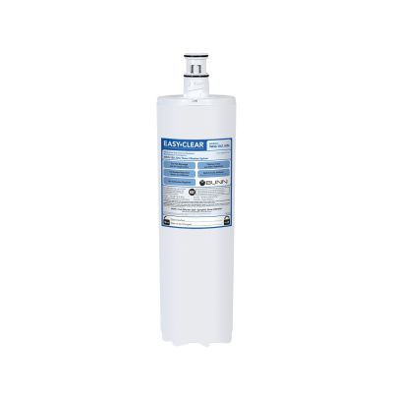
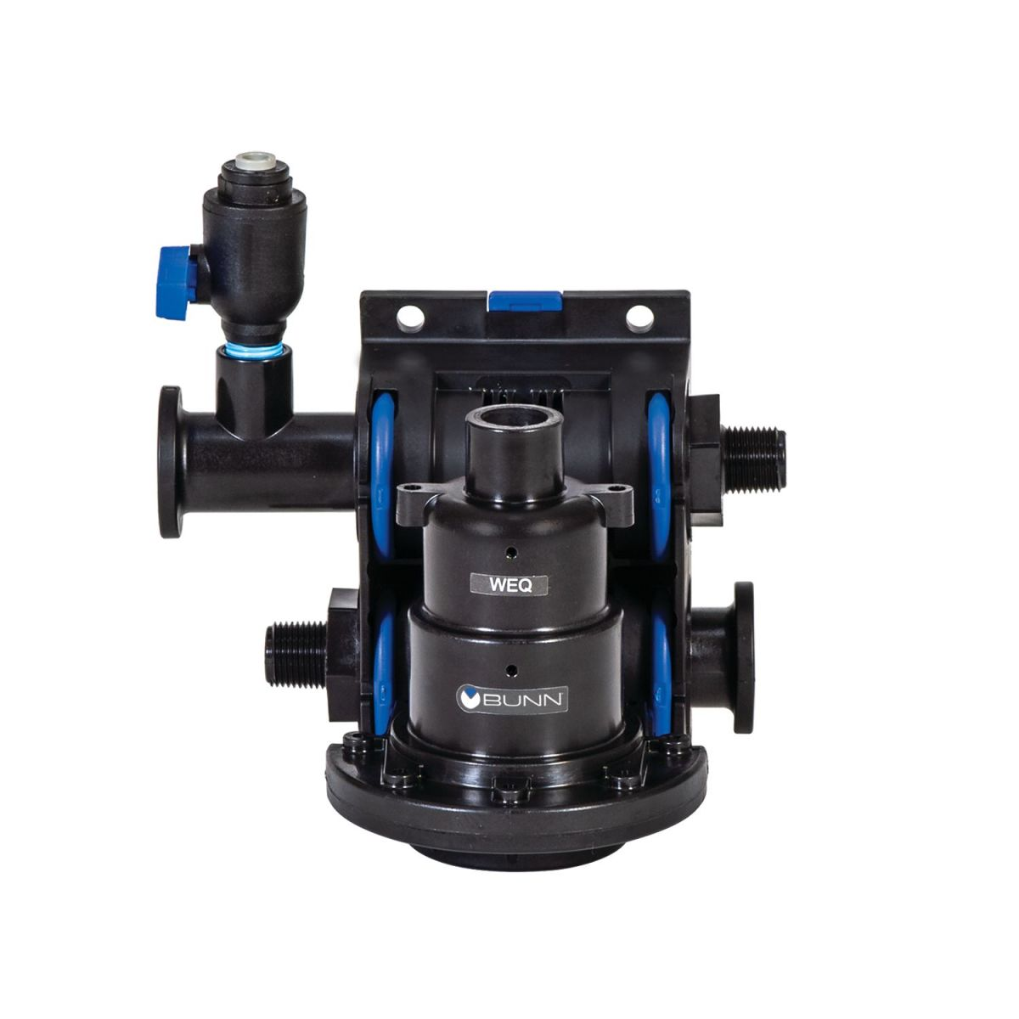
Accessories
Push Style Handle Adapter
https://commercial.bunn.com/57480.0000
Holder, POS Sign
https://commercial.bunn.com/53683.0003
Foam Brush, Tube
https://commercial.bunn.com/57892.0000
Kit, Drip Tray Twin Soft Heat
https://commercial.bunn.com/53452.0000
Kit, Drip Tray Single Soft Heat
https://commercial.bunn.com/53452.0001
WEQ-10(1.5)5L System – Hard Water Filter
https://commercial.bunn.com/56000.0024
https://commercial.bunn.com/56000.0121
https://commercial.bunn.com/56000.0201

